Slide 1
Adult Ladder Temperature Monitoring
Fish Passage Operations and Management
December 14, 2017
Brandon R. Chockley
Fish Passage Center

Slide 2
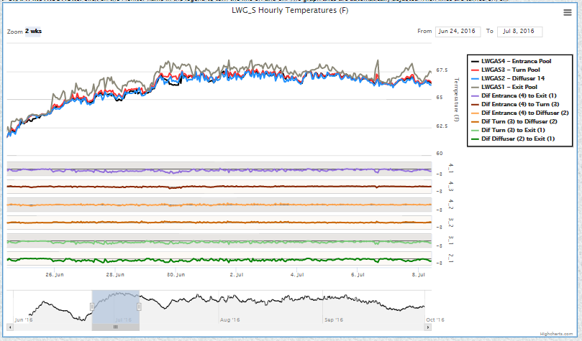
Ladder Temperature Web Query and Database
In 2016, FPC worked with COE to develop method for reporting ladder temperature data from all eight FCRPS sites
Web query displayed hourly temperature data and temperature differentials between locations of interest
Limited to 6 differentials for graphs

Slide 3
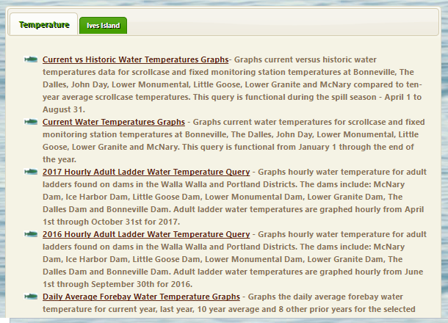
Ladder Temperature Web Query and Database
http://www.fpc.org/river/watertemp.php
Upon recommendation from FPOM and NOAA, several FCRPS sites added and/or moved temperature probes for 2017
FPC accommodated new/moved probes in 2017 with new naming scheme and web-query data table
To accommodate changes in 2017, separate web-queries needed to be maintained for 2016 and 2017

Slide 4
Ladder Temperature Web Query and Database
November 2017, FPC met with COE to discuss proposal to develop and implement new naming system for ladder temperature monitors
New system would allow all years to be accessed via single web-query
New system would accommodate new or moved probes without changes to web-query data table
Would allow FPC to retroactively fit 2016 and 2017 data into new system
COE suggested FPC provide overview of proposal to FPOM

Slide 5
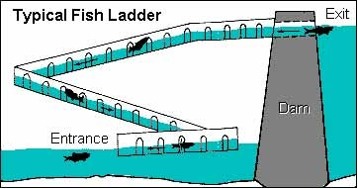
Concept for Future Years
Break each ladder into three Regions:
Entrance (TW)
Middle Section (MD)
Exit (FB)
Hypothetical Fish Ladder
Exit (FB)
Middle Section (MD)
Entrance (TW)

Slide 6
Concept for Future Years
Each Region broken into Numbered “Segments”
Each segment may or may not have a probe
Breaks between “Segments” should be strategically located (e.g., areas of water input, etc.)
If single probe moved within a segment, given same name in all years
Installation of new probe accommodated with no changes to database
Hypothetical Fish Ladder
FB1
MD3
MD4
MD2
TW1
MD1
Region Break Temp. Probe
Segment Break
Diffuser
Turn Pool
Could accommodate multiple probes in single segment

Slide 7
Concept for Future Years
Files from HOBO Probes would be sent in same format as before, with Modified Naming Scheme*
Four letter site code (LWGA, LSGA, MCNA, TDAA, etc.)
One letter “Ladder” code (N, S, E, etc.)
Bonneville: L=LPS, B=Bradford, N=WA Shore
3-digit alphanumeric Region/Segment Code* (TW1, MD1, MD2, FB1, etc.)
One letter Probe Sequence Code* (A, B, C, etc.)

Slide 8
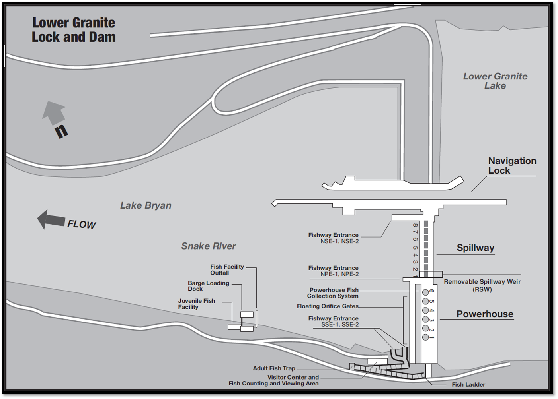
Example: Lower Granite Dam (LWGA) (Hypothetical)
Region Break
Segment Break
Diffuser
Turn Pool
Temp. Probe
1 Ladder (South, S)
6 Total Probes
3 Entrance Segments
TW1 – S. Entrances
TW2 – N. PH Entrances
TW3 – N. Spillway Entrances
Each TW segment has one probe (Probe A)
1 Exit Segment (FB1)
Single FB segment has one probe (Probe A)
TW3
TW2
TW1
FB1

Slide 9
Example: Lower Granite Dam (LWGA) (Hypothetical)
1 Ladder (South, S)
6 Total Probes
~3 Middle Segments
MD1- S. Entrance to Turnpool
MD2 – Turnpool to Diffuser 14
MD3 – Diffuser 14 to Exit
Segments MD1 and MD2 each have one probe (Probe A)
Currently no probe in MD3
TW1
FB1
MD1
MD2
MD3
Region Break Temp. Probe
Segment Break
Diffuser
Turn Pool

Slide 10
Example: Lower Granite Dam (LWGA) (Hypothetical)
Region Break
Segment Break
Diffuser
Turn Pool
Temp. Probe
1 Ladder (South, S)
6 Total Probes
LWGASTW1A, LWGASTW2A, LWGASTW3A, LWGASMD1A, LWGASMD2A, LWGASFB1A
5 Differentials (same as before)
Entrance (TW1A) to Exit (FB1A)
Entrance (TW2A) to Exit (FB1A)
Entrance (TW3A) to Exit (FB1A)
Entrance (TW1A) to Diffuser 14 (MD2A)
Diffuser 14 (MD2A) to Exit (FB1A)
TW3A
TW2A
TW1A
MD1A
FB1A
MD2A

Slide 11
Next Steps
FPC will use ladder maps to determine regions and sections for each ladder at FCRPS projects and provide details prior to January FPOM meeting for review/comments
FPC will meet with COE District Staff and/or COE biologists to further refine details (January & February)
FPC will develop single data table and incorporate 2016 & 2017 data
FPC will develop and maintain metadata for web-query, including probe locations for each year
FPC will update “manual” for downloading data and submitting files to FPC
Target date of April for receiving data?

